Slide 1
Seamless Internet with Rogers: A Customer Service Solution
By Data Ducks 🐥

Slide 2
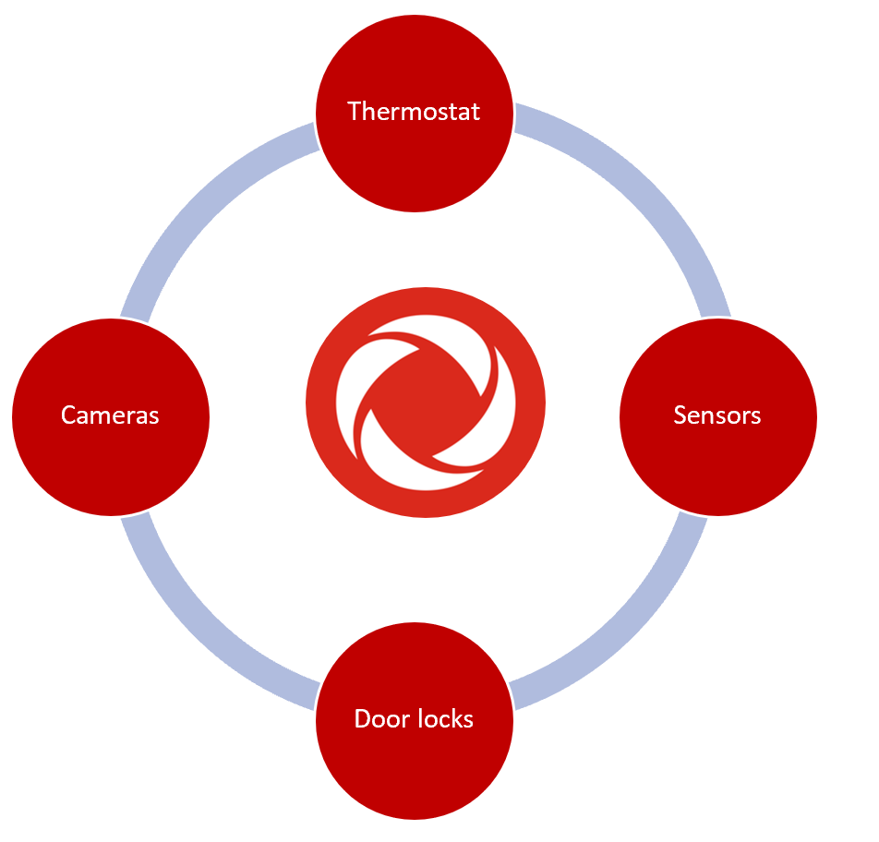
Identification of the Problem
Intermittent wifi outages
No IoT without Internet
Renders Rogers IoT solutions redundant
Unappealing to customers who rely on constant connection
Leads to customers switching ISP’s

Slide 3



Current Solution
Check the network status via
online tracking tool
Call a customer service representative
Wait without internet until it is fixed (12 - 48 hrs)

Slide 4
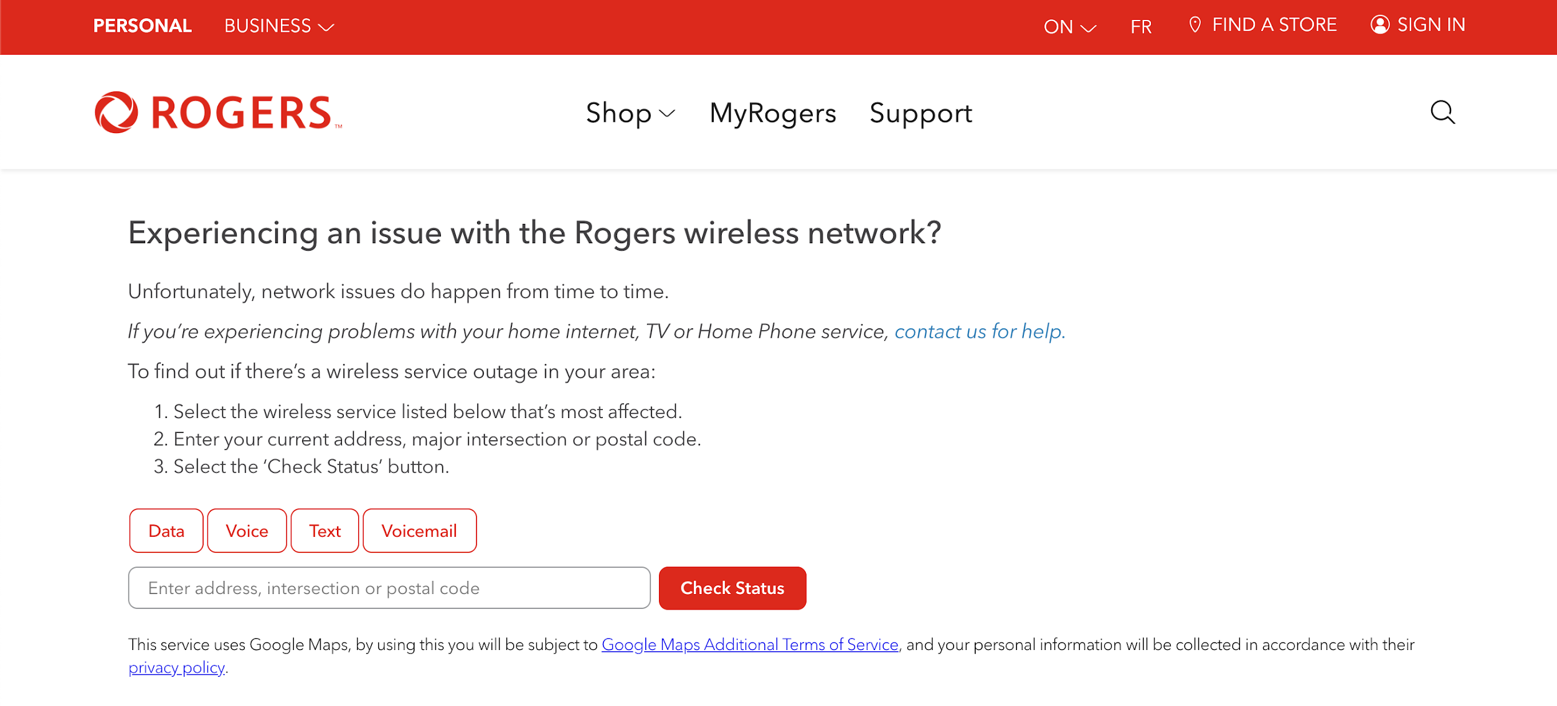
Current connection check
Plan to build off this functionality

Slide 5
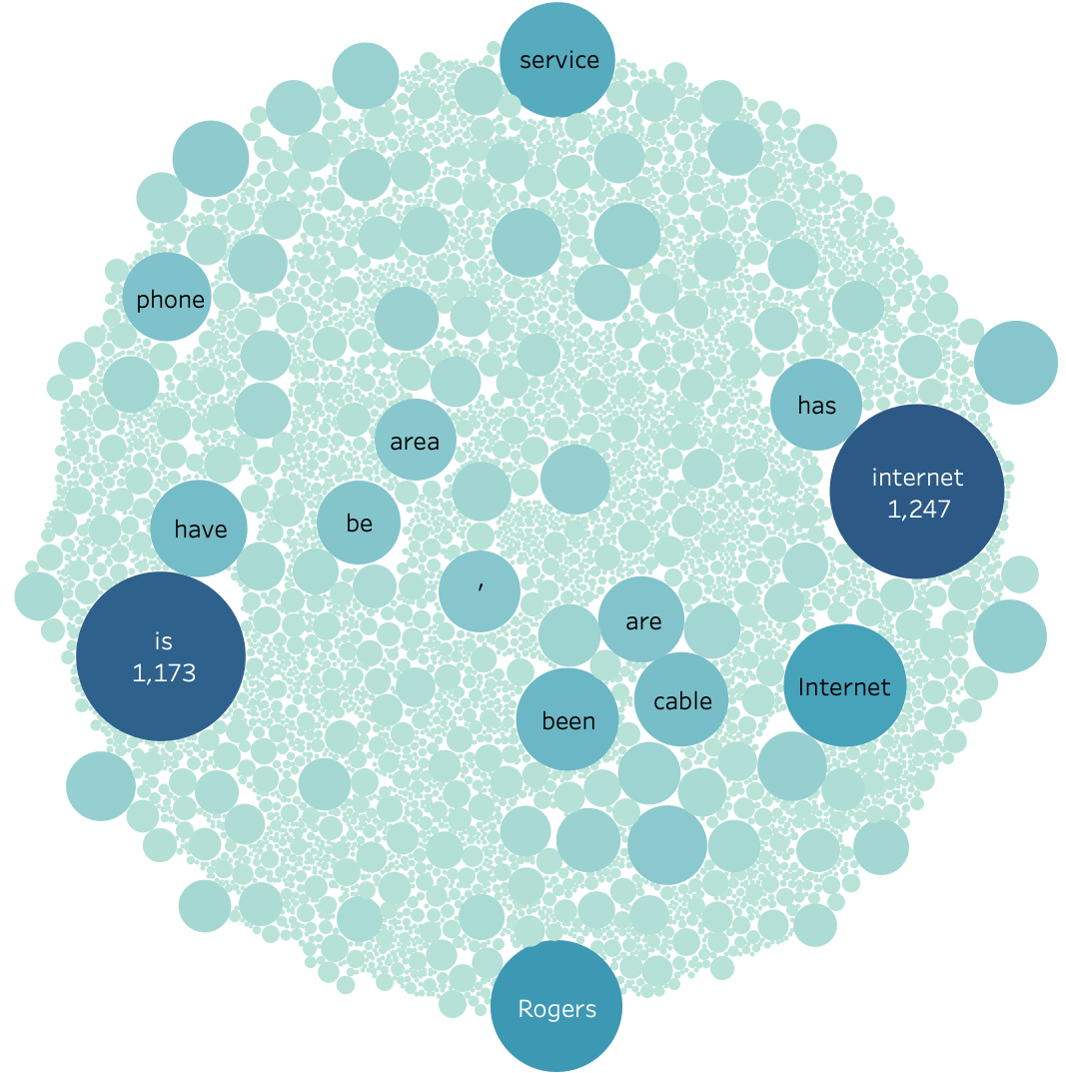
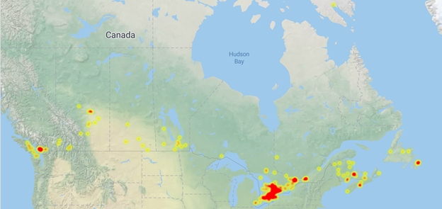
Outlining the issue
Collecting 3798 comments about Rogers from the https://istheservicedowncanada.com/status/rogers
Word tokenize and POS tag every comment.Collect all the adjectives, verbs and nouns as well as the frequencies of them.
Choosing typical words and their frequencies.

Slide 6
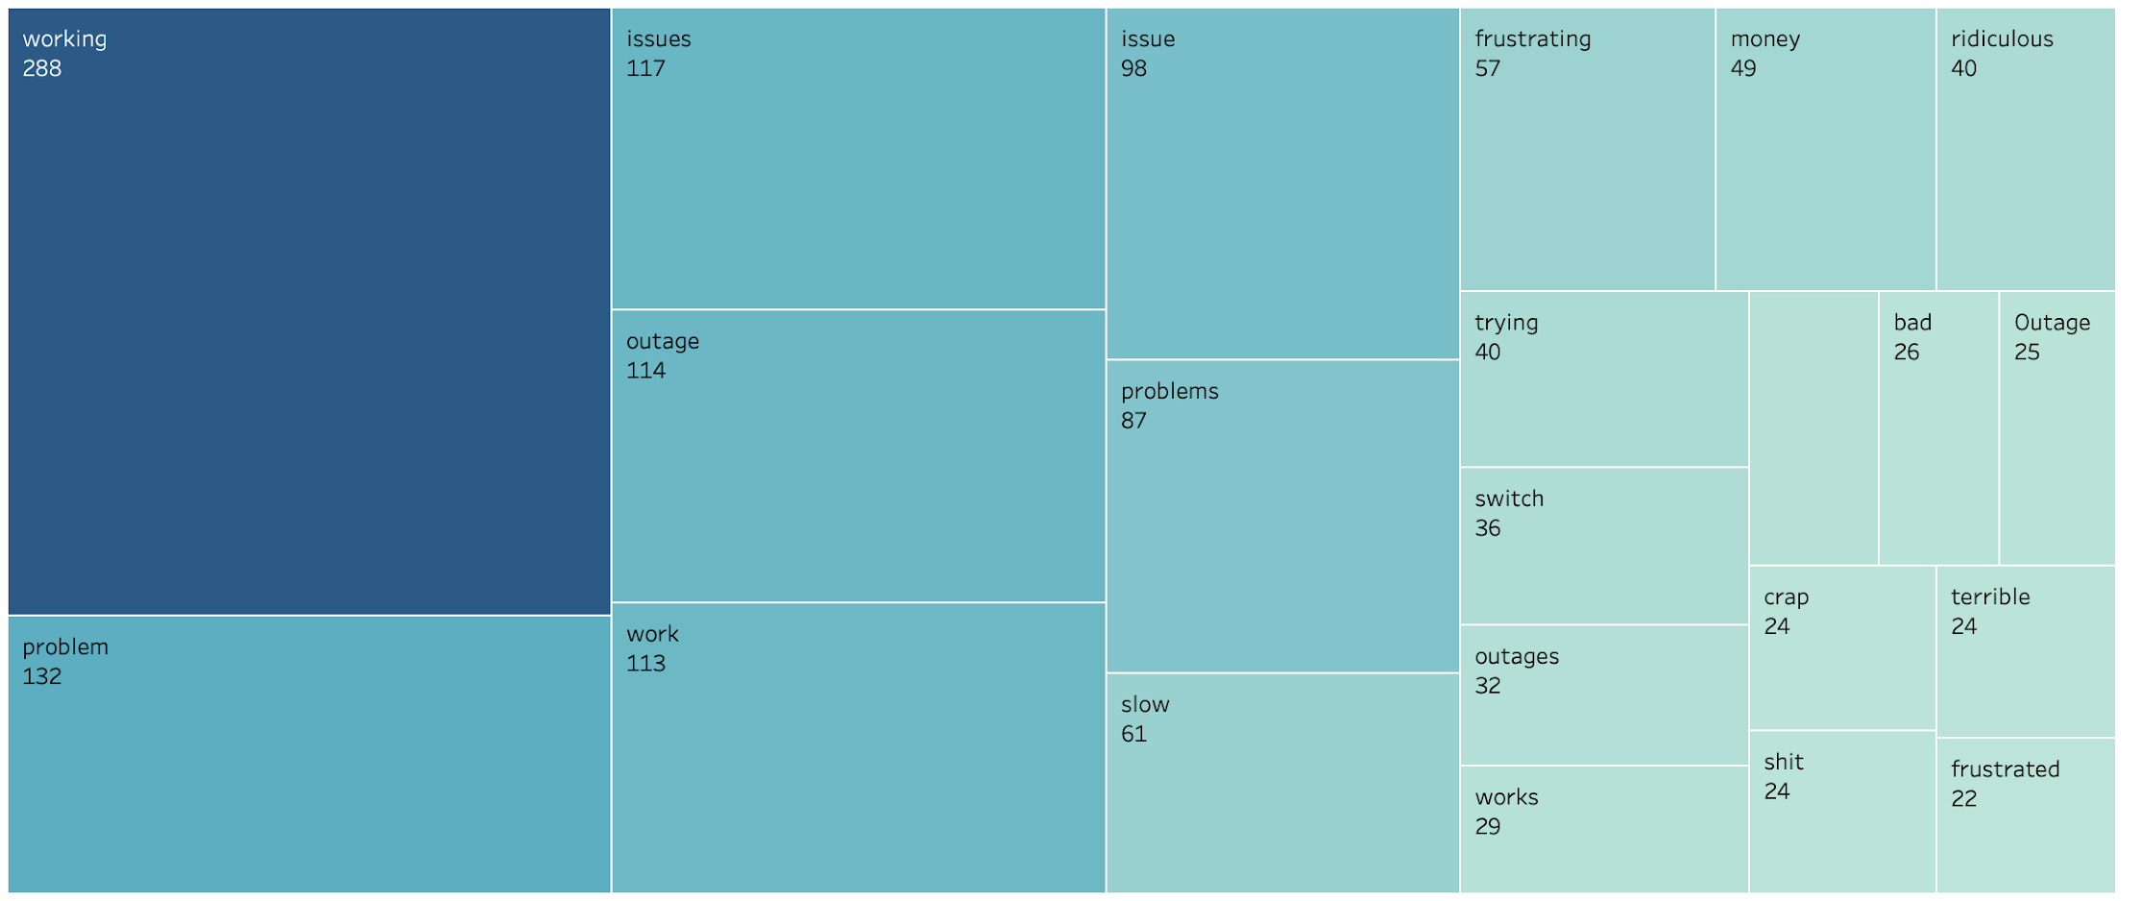
“Sighs. Maybe switching to Bell isn't such a bad idea after all. Out in Foresthill...again.”
“Since Friday night. Hurry up or I'm switching to bell”
“Still no internet, TV, or phone, Since Monday at 5am. I think this coming month we will be switching to bell and never looking back.”
“Making my switch to bell a lot easier!”
“Brampton, Ontario. Dead internet or extremely slow. wtf rogers. switching to Bell tomorrow.”

Slide 7
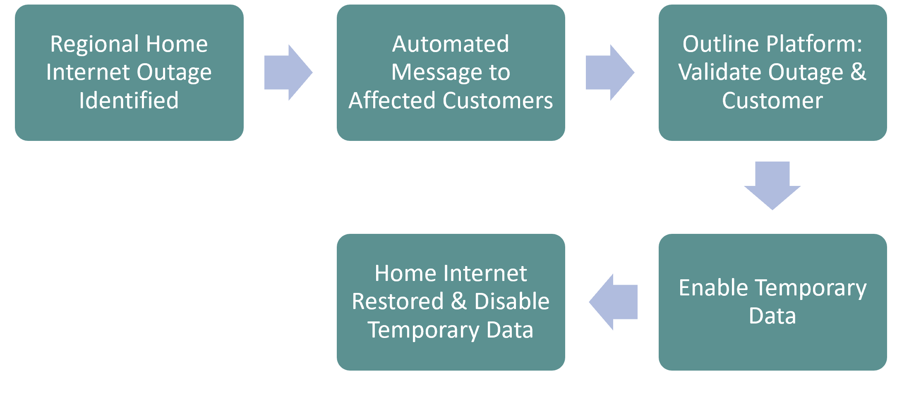
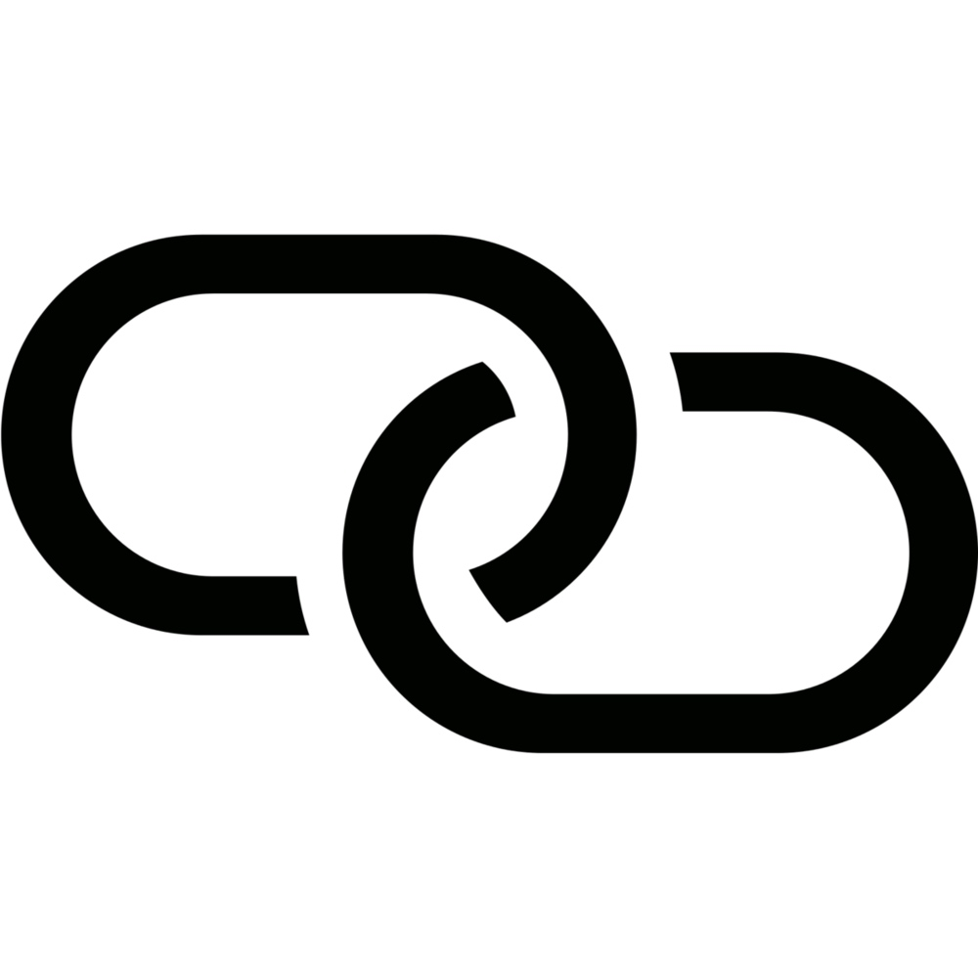

Solution
Provide seamless internet access via free mobile data transition

Slide 8
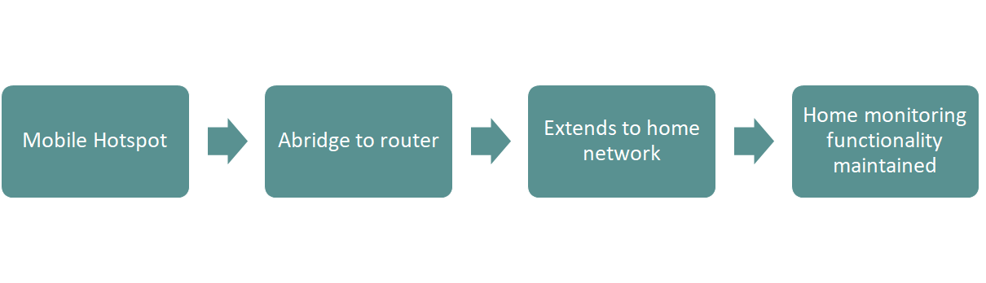
Extending across the home and IoT functions

Slide 9
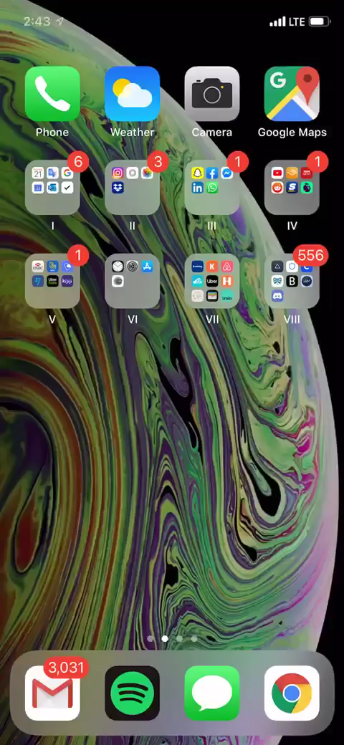
Demo Video
Receive connection text
Enter account details
Activate seamless internet connection

